Slide 1
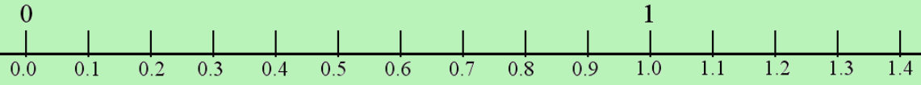
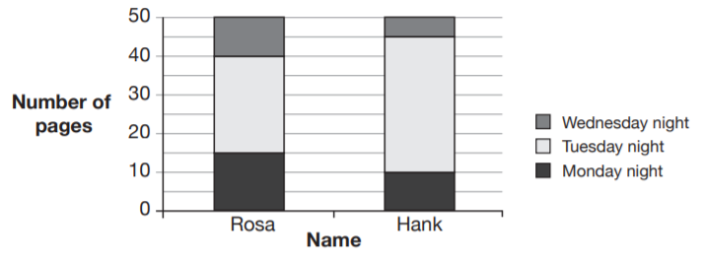
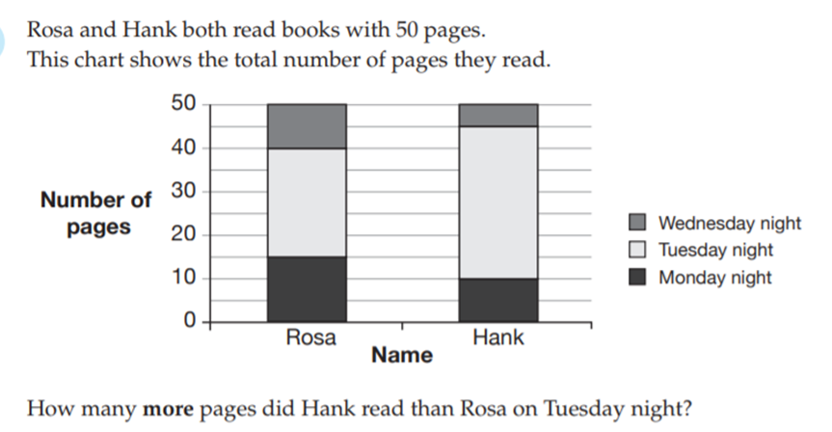
5 questions
1. If the perimeter of a triangle is 28cm and two side lengths are 10 and 9 cm how long is the third side?
2. If one side of a parallelogram is 8cm and it has a perpendicular height of 6 cm what is its area?
3. Place the following numbers on the number line
  0.08, 0.98, 0.4
4. What is 10% of 50?
5.

Slide 2

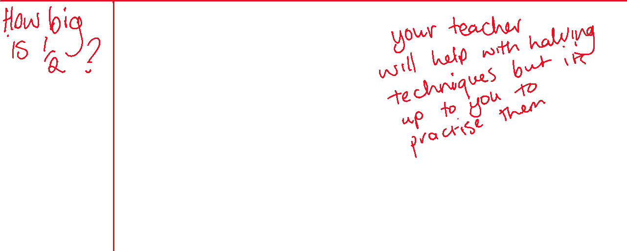



EQ:How do we find a fraction of an amount?
What is a half?
Think write share
Find a half of ….
$1.00
$100.00
$0.50
$35.00
Where does ½ go on a number line between 0 and 2?

Slide 3
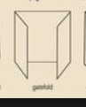
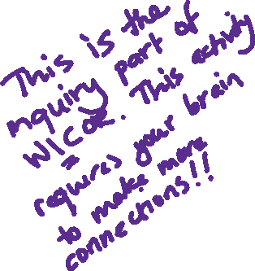


Thinking back to our definition of ½….
What fraction does this picture show?
It is time to score points for thinking hard. Make a conjecture
Use a piece of paper each to prove your conjecture true or false.
Make a new conjecture.

